Slide 1
The classical H₂⁺ ion
Christopher Kitching & Elanor Harrington
10134621 & 10134324

Slide 2

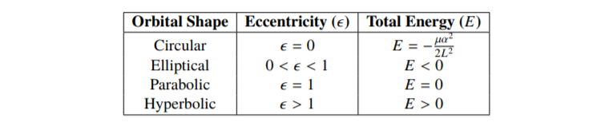
The two-body problem
Orbit equation
Table 1: A table showing the main orbital shapes of a particle in a central force field, along with the required parameter values to achieve such orbits.

Slide 3
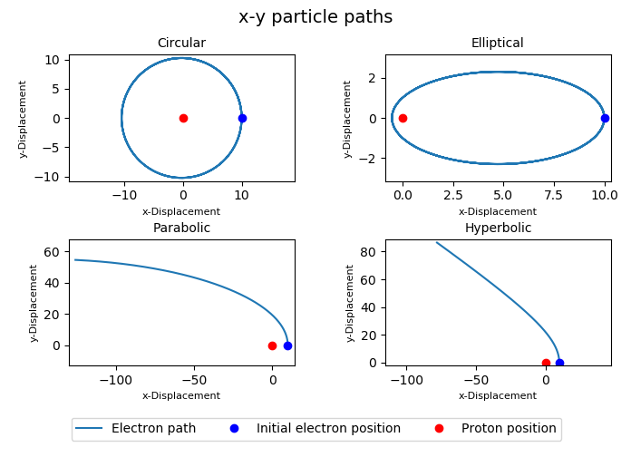
The two-body problem
Figure 1: Four subplots demonstrating the basic electron paths for an electron orbiting a single stationary proton, i.e the two-body problem.

Slide 4
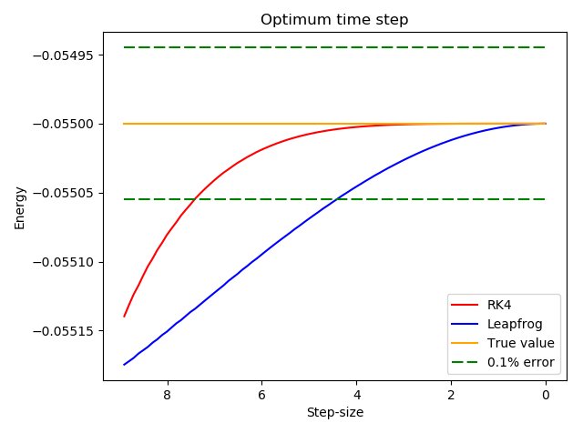
Numerical considerations
Figure 2: A plot showing the energy convergence to the initial energy value of two numerical integration methods, leapfrog and RK4, with step-size. Boundaries representing a 0.1\% difference from the true value have been highlighted.

Slide 5
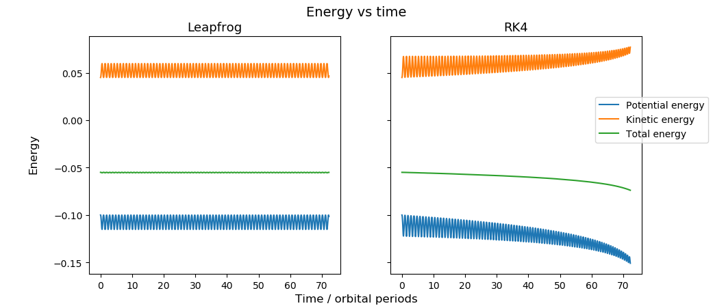
Numerical considerations
Figure 3: A plot showing the energy conservation of the system for two different numerical methods; leapfrog and RK4.

Slide 6
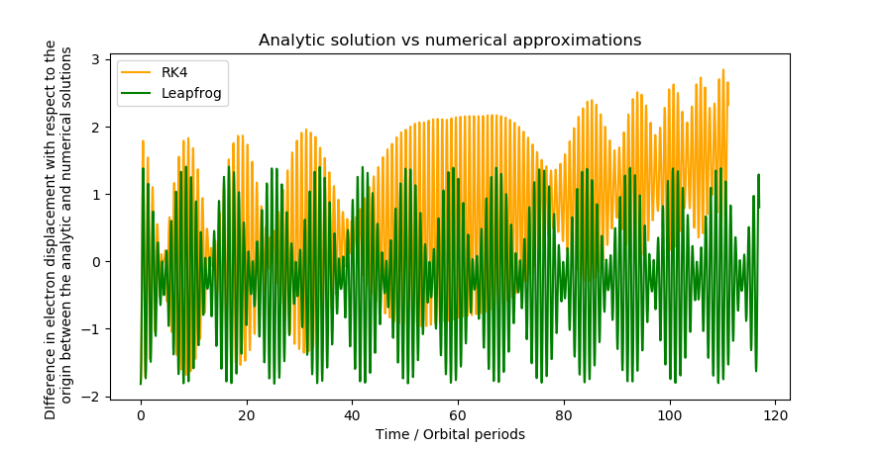
Numerical Considerations
Figure 4: A plot of the difference in the average electron displacement, with respect to the origin, between the analytic solution and the two numerical methods, leapfrog and RK4, for the two-body problem.

Slide 7
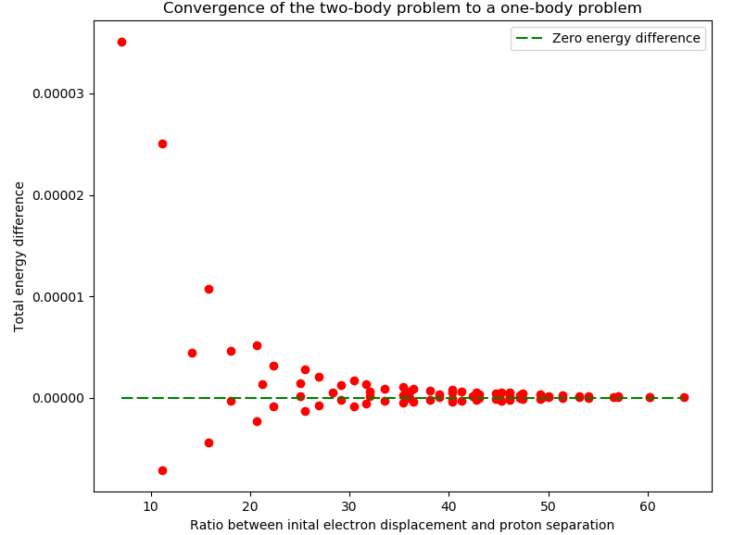
The restricted three-body problem
Figure 5: A plot of the difference in the total energy of the system between the two-body and three-body problem, against the ratio of initial electron displacement to proton separation.

Slide 8
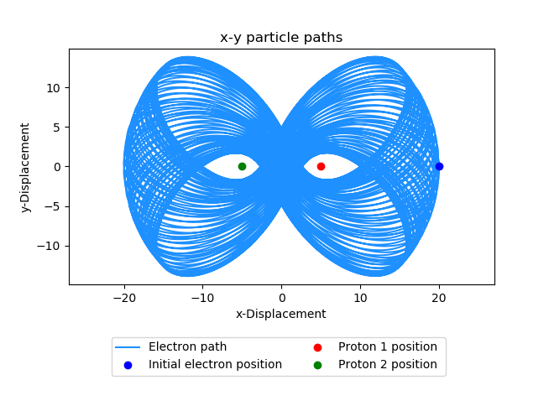
The restricted three-body problem
Figure 6: A plot showing an example orbit for the restricted three-body problem. In this case, the electron path takes the shape of a figure-eight pattern.

Slide 9
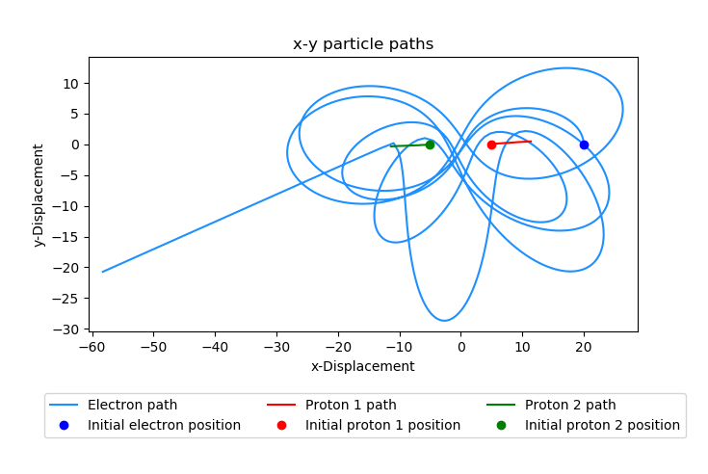
The three-body problem
Figure 7: A plot showing the paths of particles for the general three-body case. The initial conditions are the same as that used to generate Figure 6.

Slide 10
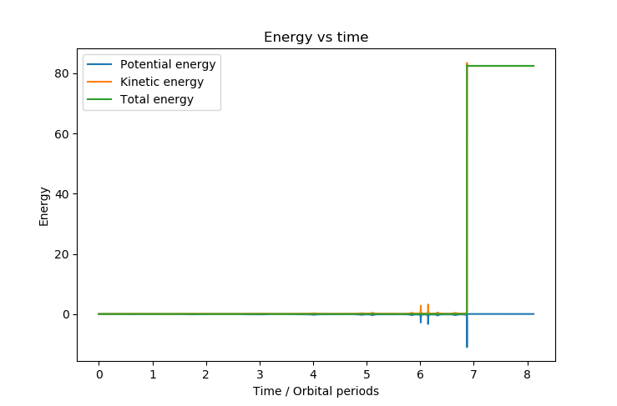
The three-body problem
Figure 8: A plot showing the energy for the three-body system. The total energy is not conserved for the entire motion.

Slide 11
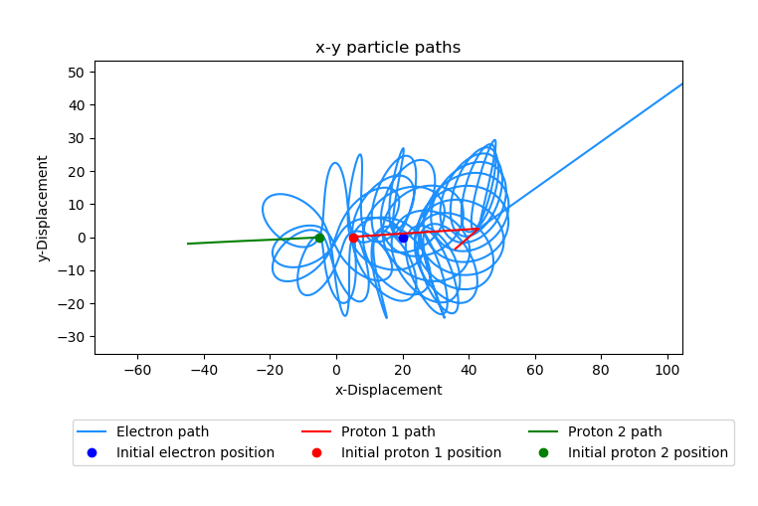
The three-body problem
Figure 9: A plot showing the x-y path of the electron and the two protons for the three body case using a variable time-step. The same initial conditions as in Figure 7 have been used.

Slide 12
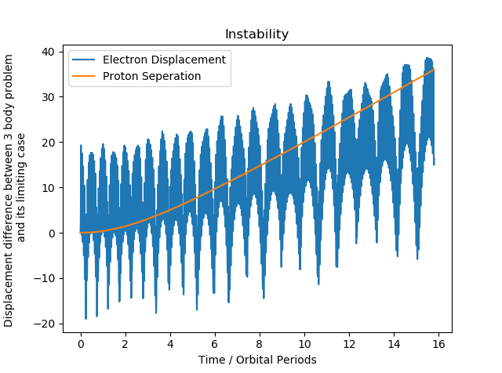
The three-body problem
Figure 10: A plot showing the proton separation and the electron displacement with respect to the origin in the case of the general three-body problem. The separation of the protons gradually increases as they repel each other, while the electron stays bound and orbits one of the protons.

Slide 13
Thank you for listening

